Slide 1

Water Bottle Rocketry
UC Astro Cats

Slide 2
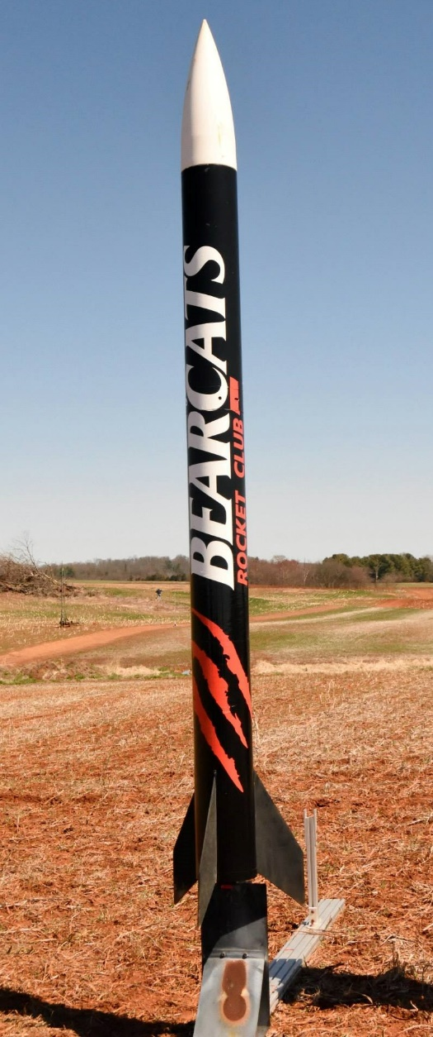
Who are We?
Senior Design team from University of Cincinnati
Competing in NASA competition to launch a rocket 1 mile into the sky and gather data

Slide 3
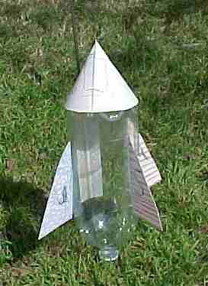
What is a water rocket?
Water rockets are powered by compressed air and water
Made from a 2 L pop bottle
Can reach speeds of 180 mph in as little as 1/10 of a second

Slide 4
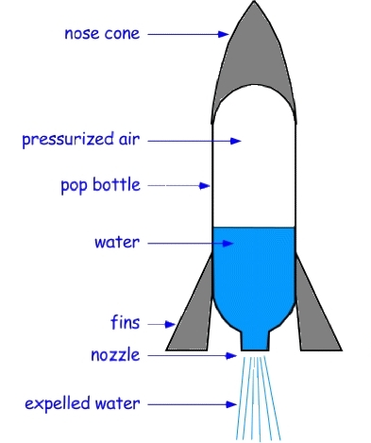
Building a rocket
Using the fin materials given, design your own rocket
Cardboard, plastic, and foam
When done, see your instructor for a safety check
After safety check, it’s time to launch

Slide 5
Safety
Water rockets can be dangerous
To increase safety we will use the following rules
Only pressurize to 60 psi
Only launch one rocket at a time
Stand back several feet when launching
Instructors will safety check all bottles before launch
Pay attention to your surroundings

Slide 6

Concepts - Thrust
Water rockets create thrust by propelling water backwards
This demonstrates newton's 3rd law
For every action there is a equal and opposite reaction

Slide 7
Concepts - Stability
In order to make the rocket fly straight, it must be stable
Two concepts relate to stability
Center of Gravity
Where you can balance the rocket
Center of Pressure
Where you can balance a paper cutout of the rocket

Slide 8
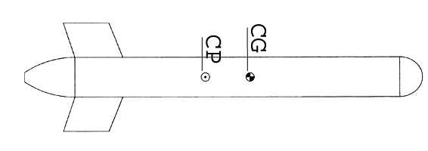
Concepts - Stability
Rockets are stable if the Center of Gravity is more towards the nose than the Center of Pressure
We will tape a tennis ball to the nose to make the Center of Gravity close to the nose
We will add fins to move the Center of Pressure towards the tail

Slide 9

Concepts - Drag
Drag is the force of the air on the water rocket
Proportional to the surface area and shape
We can reduce drag by taping a cone shape to the top of the bottle
Drag can be reduced by using smaller fins
Too small fins make the rocket unstable

Slide 10
Concepts - Fin Design
Fins must be sized in a way to stabilize the rocket, but not be too large
Think how to balance stability vs. drag
Some fin materials are better than others
Think which of the provided materials are most durable
Possible Designs

